Slide 1
Plant Disease Detection System for Sustainable Agriculture

Slide 2
Learning Objectives
Tools and Technology used
Methodology
Problem Statement and Solution
Conclusion

Slide 3
Learning Objectives Understanding Machine Learning in Agriculture Image Processing and Analysis Deep Learning Model Implementation (CNN for multiclass classification) Streamlit for Application Development Understand the use of TensorFlow and Keras for training and deploying deep learning models.

Slide 4
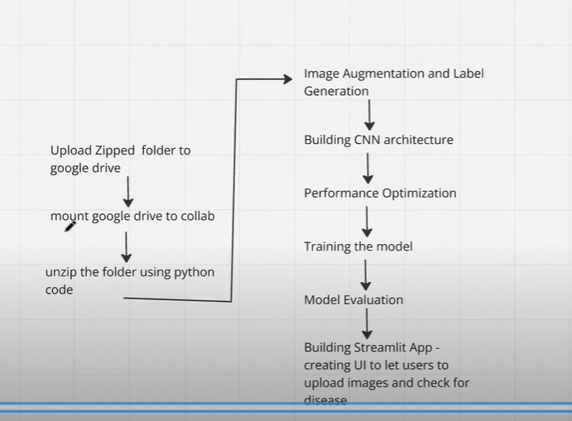
Tools and Technologies Programming Language: Python Libraries: TensorFlow, Keras, OpenCV, NumPy, Pillow, Streamlit Development Tools: Visual Studio Code Machine Learning: Convolutional Neural Networks (CNNs) Dataset: Plant Disease Dataset (labelled images of healthy and diseased plants) Deployment: Streamlit (for interactive web app) Operating System: Windows
Flow diagram of model

Slide 5
METHODOLOGY
Our Model aims for providing a solution at early stage and hence observation from leaves for the identification of diseases is crucial. For any plant disease it is known that leaves are the major regions where initial symptoms are found.
Hence considering the images of leaves, the methodology uses Convolutional Neural Network to train with infected and healthy plant images.
Methodology used Convolutional Neural Network to train with infected and healthy plant images.
The train dataset is used to train the model (CNN) so that it can identify the test image and the disease it has. CNN has different layers that are Dense, Dropout, Activation, Flatten, Convolution2D, and MaxPooling2D.
After the model is trained successfully, the software can identify the disease detection contained in the dataset. After successful training and preprocessing, comparison of the test image and trained model takes place to detect the disease detection.
Integrate the trained model into a user-friendly website using Streamlit.

Slide 6
PROBLEM STATEMENT
Developing a CNN-based model capable of detecting and classifying plant diseases from images of leaves of various crops such as apple, cherry, grape and corn.
The model should accurately identify both healthy and diseased leaves while predicting the specific type of disease.
- This system will aid in precision agriculture by enabling early detection and effective disease management.

Slide 7
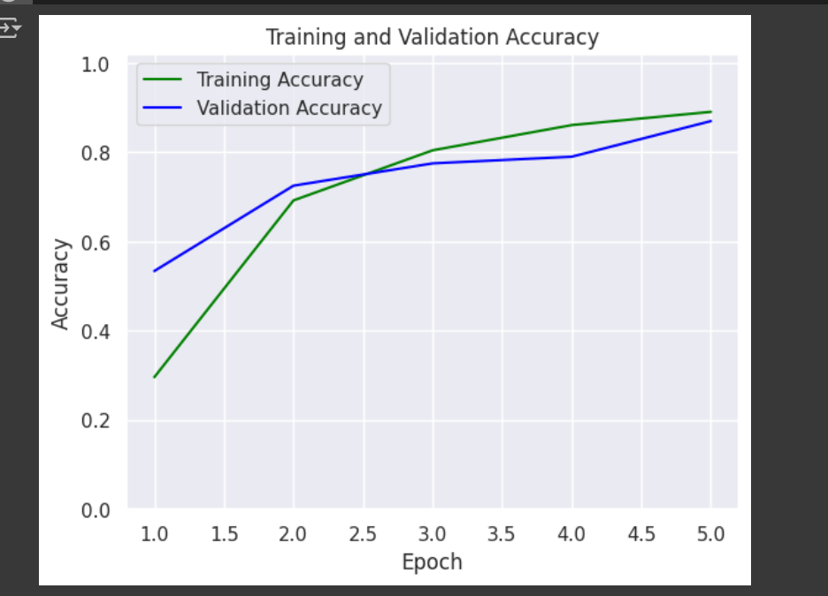
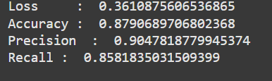
SOLUTION
We are implementing a CNN-based model that accurately detects and classifies plant diseases from leaf images, identifying both healthy and diseased conditions.
The system aims to support precision agriculture by enabling early diagnosis and improving crop management practices.

Slide 8
CONCLUSION
A deep-learning model was successfully developed to detect and classify plant leaf diseases with high accuracy.
The CNN-based approach demonstrated an accuracy of 87%, proving its effectiveness in identifying diseased and healthy leaves.
The system supports precision agriculture by enabling early disease detection and improving crop management practices.
This solution can significantly reduce crop losses and promote sustainable farming.

Slide 9
thank you
PALLAVI
INTERNSHIP_173070615967287aef12823

